Slide 1

Pennine Acute NHS Trust
Our Journey So Far ..
Meet the team
Penny Martin – Divisional Managing Director
Jen McCartney – Divisional Support Manager
Lewis Stott – Assistant Directorate Manager
Notes:
Penny to welcome and introduce the team

Slide 2


CQC 2016…….
:
Inadequate

Slide 3
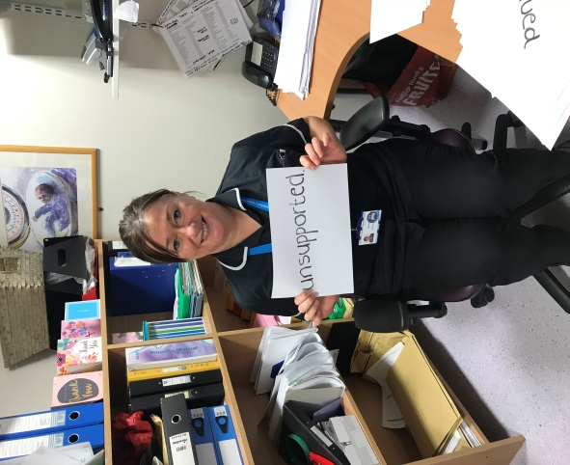
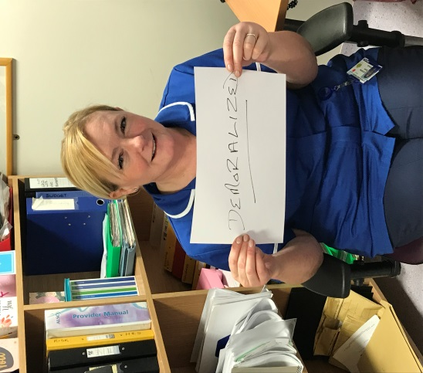
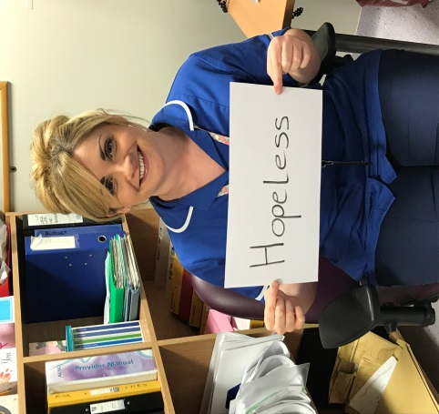
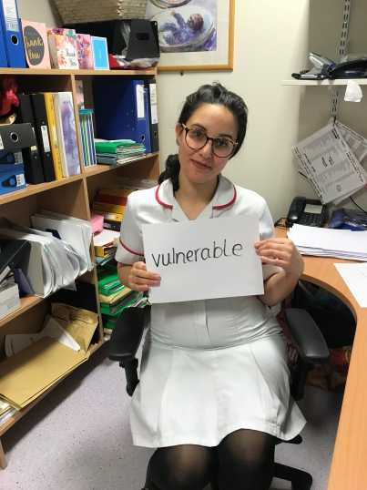
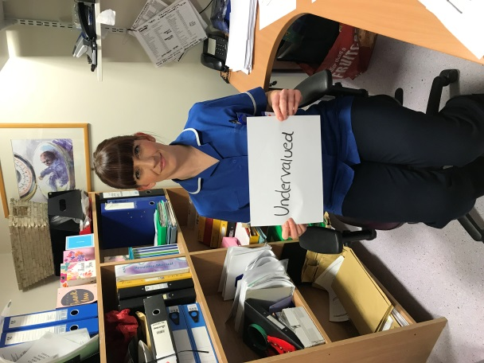
Staff felt……

Slide 4
Led to…….
New leadership team established early 2016 in response to CQC report
Create Governance team – Systems and Processes
CQC improvement Action plan
Staff engagement – New approach
Review of service

Slide 5


What happened next…
May 2017 successful application to join wave 1 of the NHSI Maternity & Neonatal Safety Collaborative
Our Approach
Focus on
“Saving babies” A framework for improvement
Improving the identification and management of sepsis in babies
Improving the reliability of fetal monitoring and neonatal resuscitation
Human Factors – Break the Rules for Better Care
Our Challenges
Time
Staff engagement
Focus

Slide 6

Our focus today? Break the Rules for Better Care

Slide 7
‘Break The Rules For Great Care’
4.a) Work with Mothers and families to improve their experience of safer care. - Run the ‘ Break the Rules for great care programme’ to collate minimum 500 responses from women and families and staff and report findings by 31st January 2018.
Stakeholder Engagement
Patient experience midwife role links with careopinion /Healthwatch engagement events ie @whose shoes
MLAG members and representatives to be involved in work streams of their choice
TED (Time; Escalation; Decision)
Teaching resource to be used to lead improvement
Interactive workshop using TED at ‘Saving babies’ launch 18th October 2017
Develop TED cascade training for all staff
Implement
‘Listen to me’ programme
Develop guideline using the ‘Listen to me’ resource
Launch & cascade teach ‘Listen to me’
Embed ‘Listen to me’ in mandatory training
Run
‘Break the rules for great care programme’
5 day event aiming for 500 responses from staff/women/ families
Collate, respond and disseminate findings
Measures:

Slide 8


How to get involved
Cascade approach with an aim of 500 responses
Survey monkey
Paper survey
Completely anonymous

Slide 9

“If you could break one rule for better care what would it be and why?”
“If you could change one aspect of your care what would it be and why?”

Slide 10
Categories…
Myth-busting!
Rules that need Clarity
Rules that need advocacy
Rules that need redesign

Slide 11
PDSA Testing
Welcome
Aim – To receive 500 responses in 5 day period
D
S
P
A
1E: Collate information review PDSA – 495 responses received
A
P
S
D
D
Cycle 1D: Small team floor walking to spread the word
S
P
A
A
Cycle 1C: Email sent to all staff signposting ways to respond
S
P
D
Cycle 1B: Email sent to all managers with links to survey monkey and signposting paper survey (cascade approach)
A
P
S
D
Cycle 1A: Posters and launch presentation to management team

Slide 12
Analysis and themes
Themes
Medication processes
Agency staff capability
IT systems
Lumber puncture process
Birth companions
Paperwork
Pain relief
Myth / clarity fact sheet to go out to all staff
Break the rules compliment board to display all the positive comments for our service
Rules that need redesign / clarity will be themed and established as workstreams

Slide 13

Women and Families at the heart of everything
Care Opinion
Maternity Quality Improvement Forum
Whose Shoes
Maternity Voices
Patient Experience Midwife

Slide 14
Lessons Learned
Recognition of slow start
Strengthen relationship and utilise support from Health Innovation and AQUA
Build on engagement from Break the Rules to continuously improve services in conjunction with staff and patients
Using Life system share knowledge and learn from other Trusts
Celebrate success of Break the Rules Campaign with teams and share compliments received during the campaign to continuously boost morale

Slide 15

And our advice to you …
Start small
Go where the energy is ..
Use your data!

Slide 16

Any Questions

