Slide 1
How communication underpins all Quality Improvement
Natalie Balmain

Slide 2
The mission
“The NHS should continually and forever reduce patient harm by embracing wholeheartedly an ethic of learning”
– Berwick report, 2013
Learning
Connecting
Complaints
Transparency
Clear
“Communications is as much about listening as talking”

Slide 3
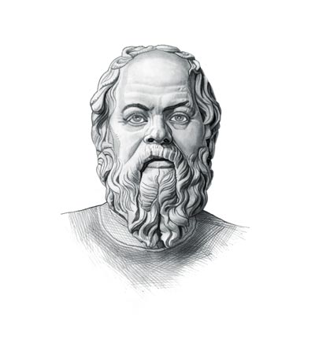
To improve, we must accept our imperfection
“I am wiser than this man, for neither of us appears to know anything great and good; but he fancies he knows something, although he knows nothing- whereas I do not fancy I do. In this trifling particular, then, I appear to be wiser than he, because I do not fancy I know what I do not know.” – Socrates

Slide 4
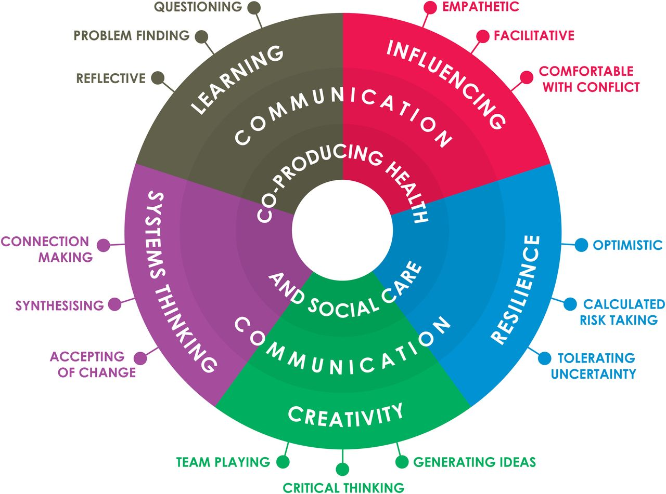
What part do communications play in this?
Framing and defining key issue/s
Disseminating information to promote adoption and spread
Reaffirming aims and values to frontline staff
Promoting sustained engagement
Profile building in media
Creating awareness within patient populations and the public

Slide 5
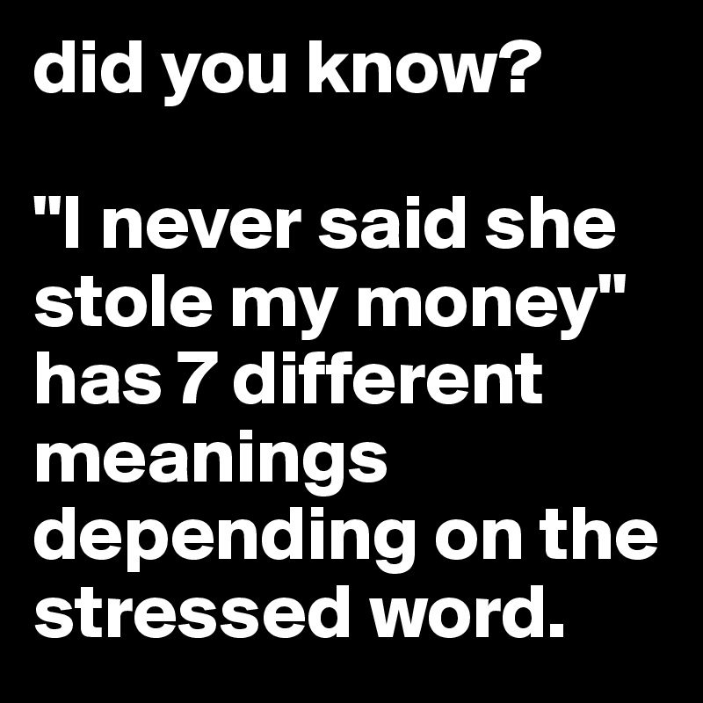
But, communications is easy..?

Slide 6
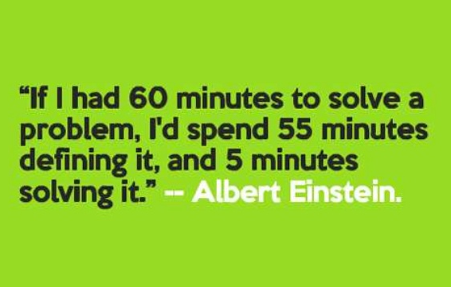
Poorly addressed problems are usually poorly defined problems

Slide 7
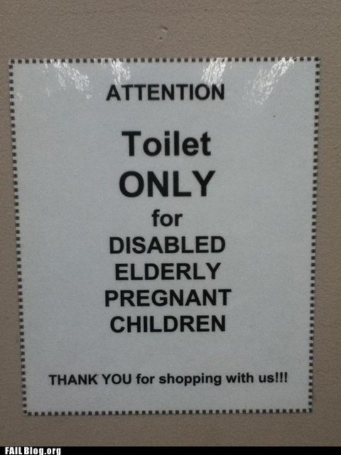
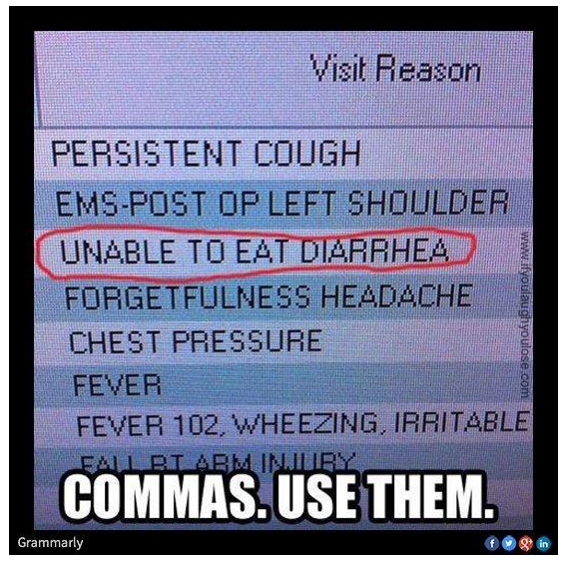
Good communication must consider all interpretations

Slide 8
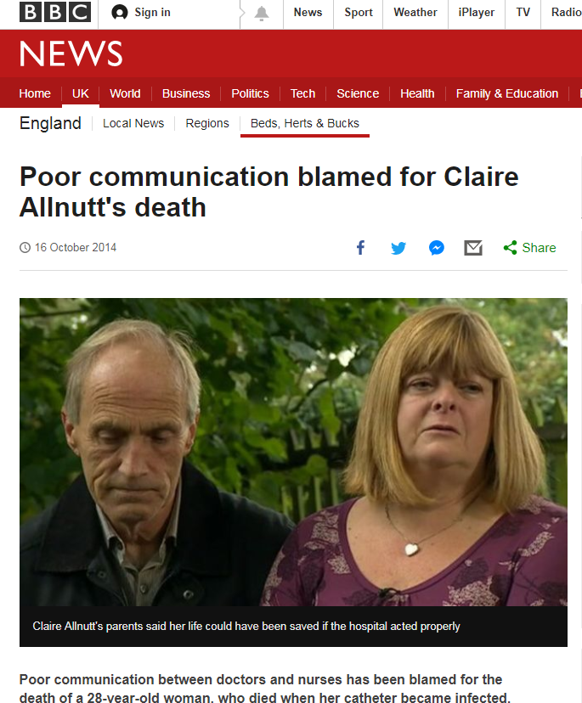
Worst case scenarios
Poo

Slide 9
Bad vs. Good
Poor communication
Poor communication can have the worst possible consequences
One US study conducted in the late 1990s found that poor communication was responsible for causing between 44,000 and 98,000 patient deaths annually in American hospitals alone
Good communication
Good communication not only improves the safety of the procedures we currently have in place, but is a catalyst for the adoption and spread of new practices, treatments and innovations that will improve outcomes for everyone (not just patients!)

Slide 10
The benefits of effective communication
Precise definition and clear understanding of problems
Faster and more effective problem-solving
Wider spread and faster adoption times of innovations and interventions
Improved staff engagement and staff morale
Which in turn creates:
Improved work flows (more cost effective?)
More engaged frontline staff making fewer mistakes (improved care)
Improved patient outcomes = better patient experience
Better professional image for your organisation

Slide 11
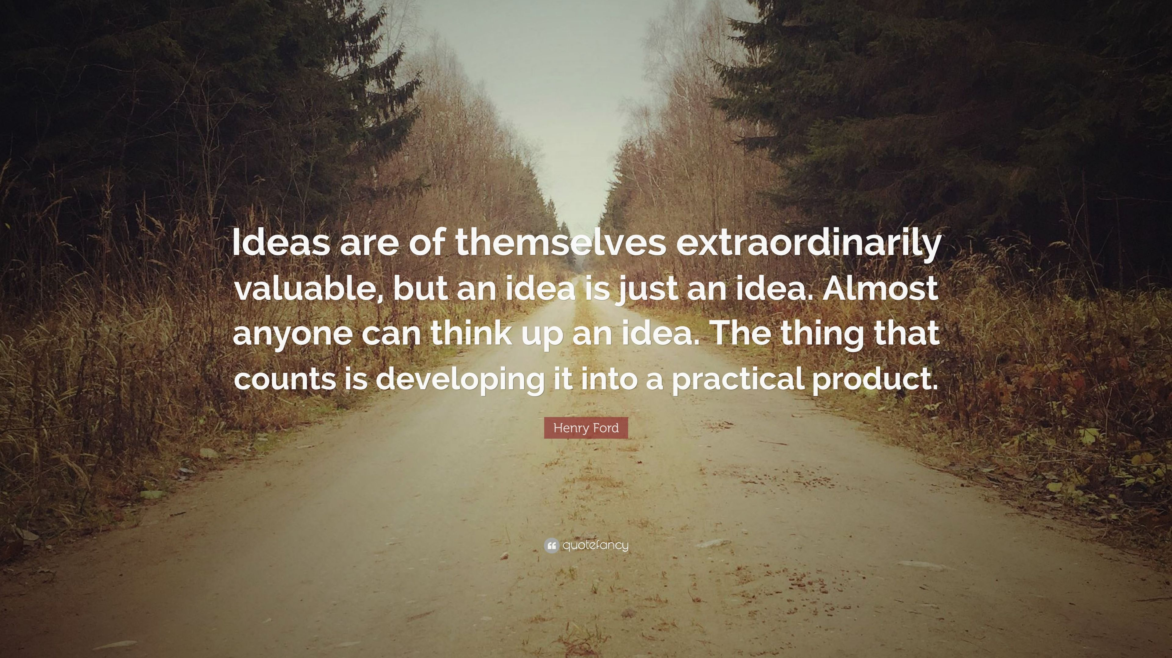
What good is an idea?

Slide 12
What can I do?
Think about the work you are trying to communicate, the landscape it sits within, the stakeholders involved (your audiences) and any sensitivities. You will need to tailor your message to appeal to different stakeholders/audiences!
Plan your communications! The best improvement programmes have been planned in advance either collaboratively, or with consideration of, key stakeholders.
What? Who? How? When?
Language matters. Just because you may not have a sensitivity to certain language, does not mean others don’t. Disengaging your stakeholders with careless language is a major barrier to adoption and spread- especially if that stakeholder is a key influencer.
Adapt to survive! - Remember that ideas and innovations can evolve and grow as the work develops, and so your messages may also need to be reviewed.

Slide 13

Thank you…

