Slide 1


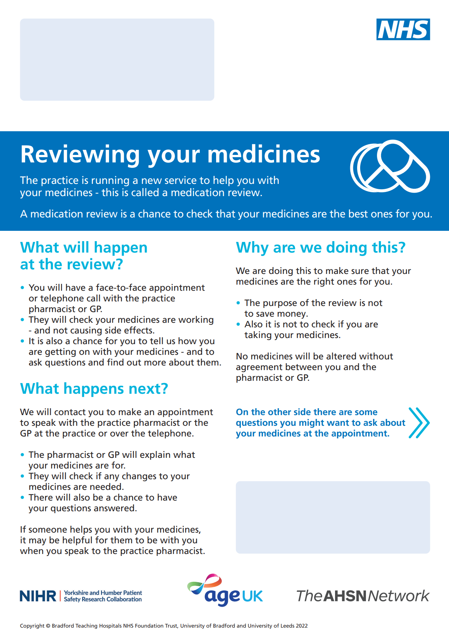
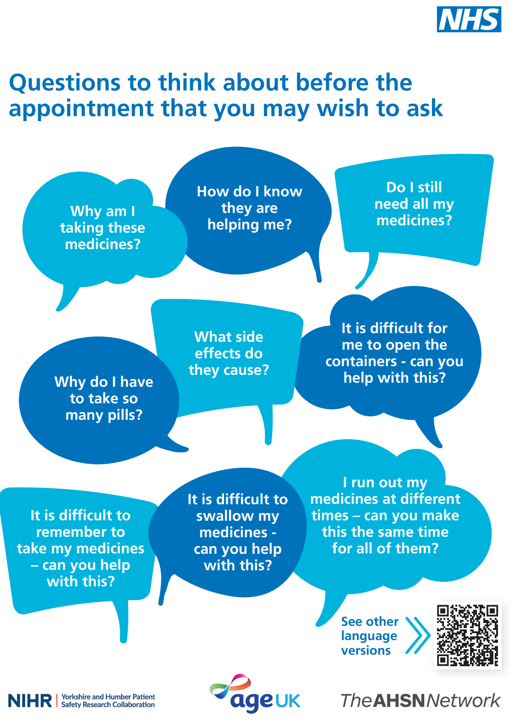


We want to understand if these materials will help patients be more confident about talking to their GP or Pharmacist about their medicines prior to their medication review
Supporting patients before a medication review:
A patient invitation letter for a structured medication review, explaining what a medication review is, why the patient has been invited and some questions the patient may wish to consider before meeting with their GP or pharmacist.

Slide 2
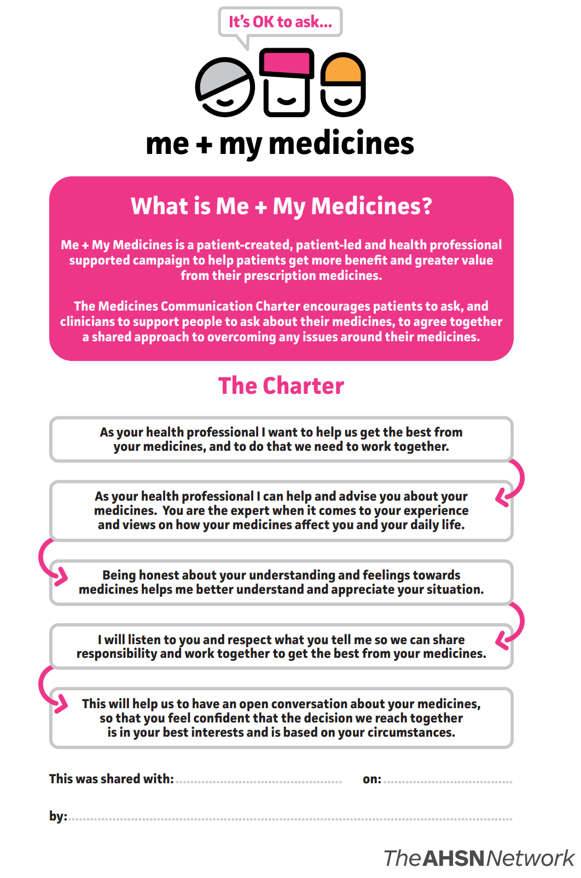
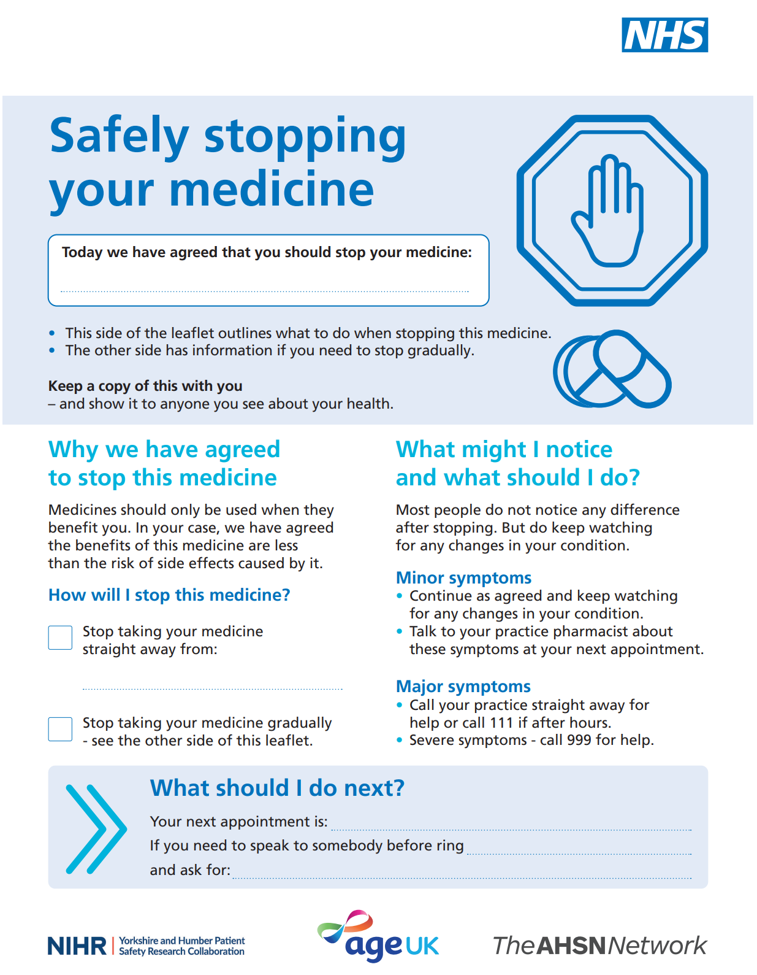
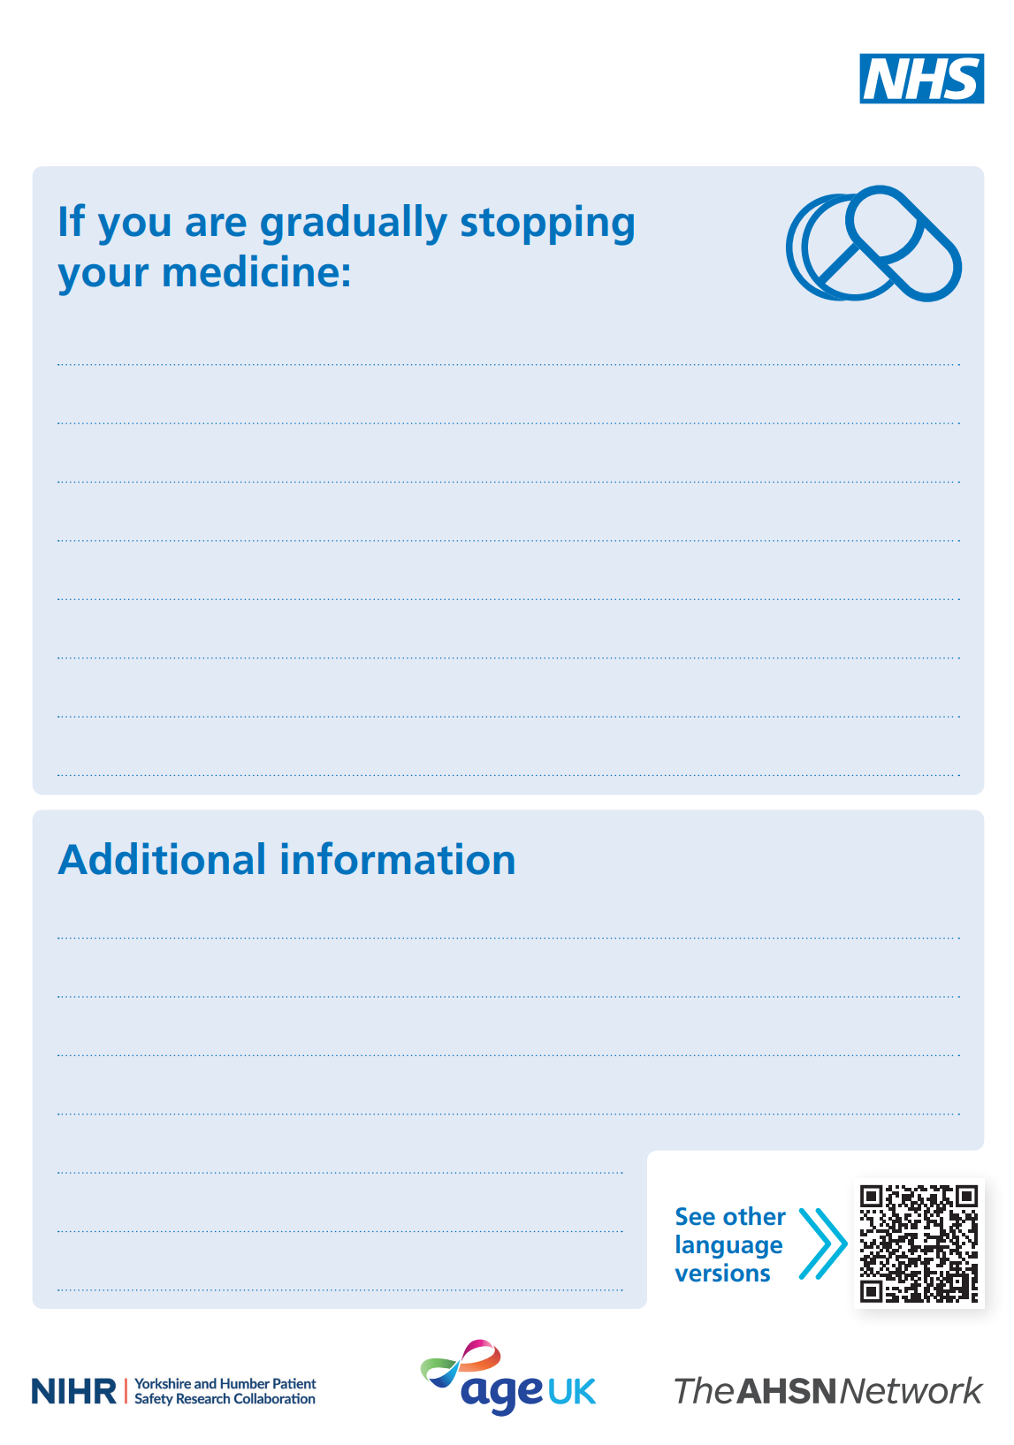
Supporting patients during a medication review:
Safely stopping your medicine patient leaflet for patients when there is an agreement that a medicine is to be stopped, or gradually stopped.
Me and My Medicines Communication Charter, a patient led, co-produced public information approach to encourage better conversations about medicines between patients and healthcare professionals. https://meandmymedicines.org.uk

Slide 3
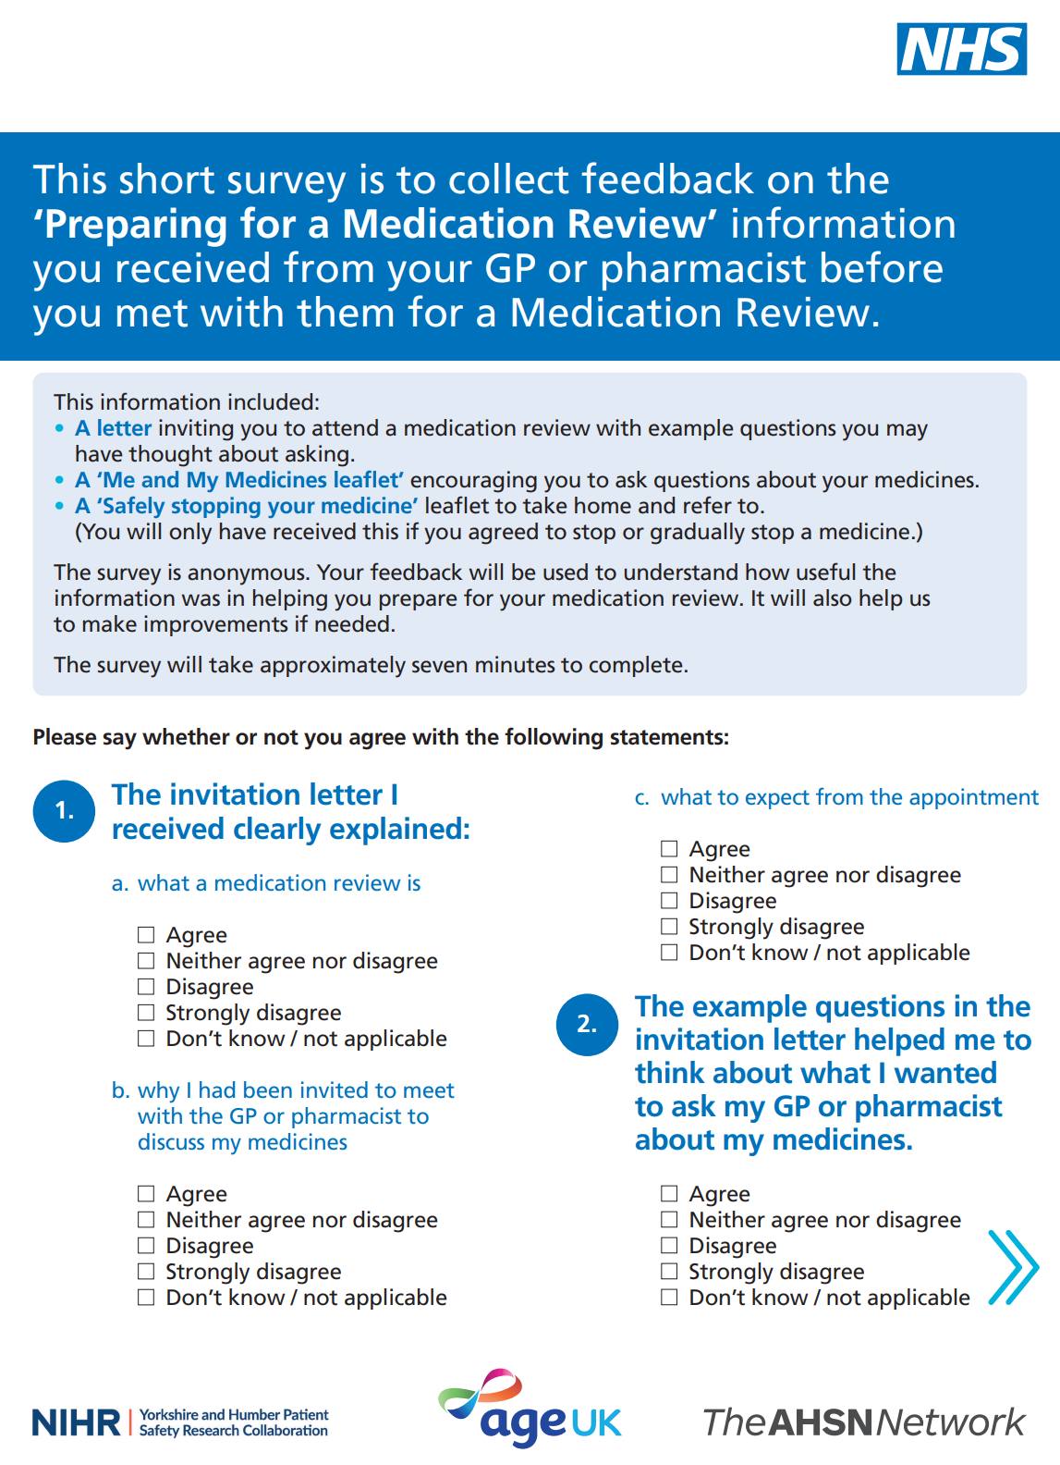
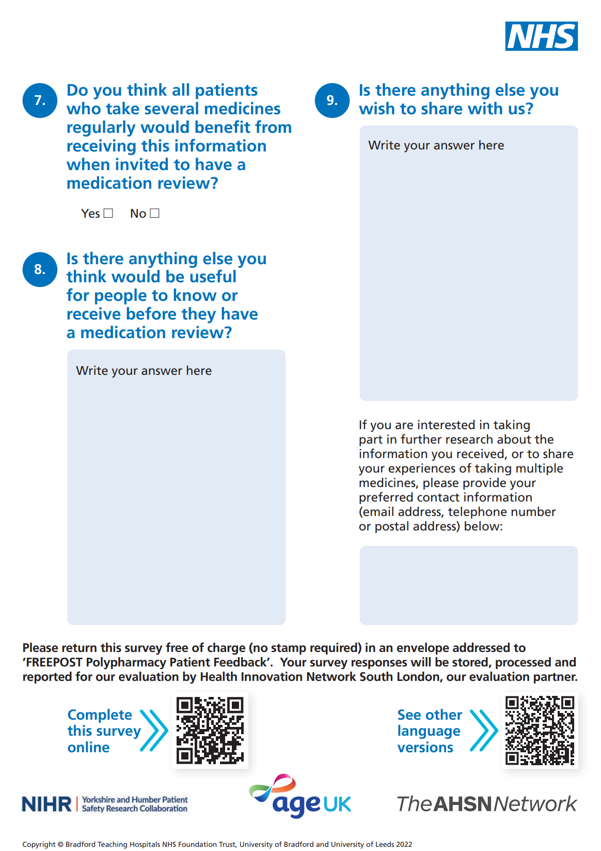
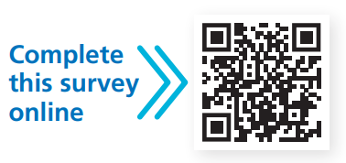
Gathering feedback on the medication review:
Patient survey for gathering feedback on the usefulness of the materials in preparing them for a medication review.
https://survey.zohopublic.eu/zs/SNBjOu
FREEPOST address now available to return patient surveys to - ‘FREEPOST Polypharmacy Patient Feedback’.
Clinician survey for feedback on the usefulness of the materials would also be appreciated - Polypharmacy SMR Patient Resources Clinician Survey (zohopublic.eu)

Slide 4
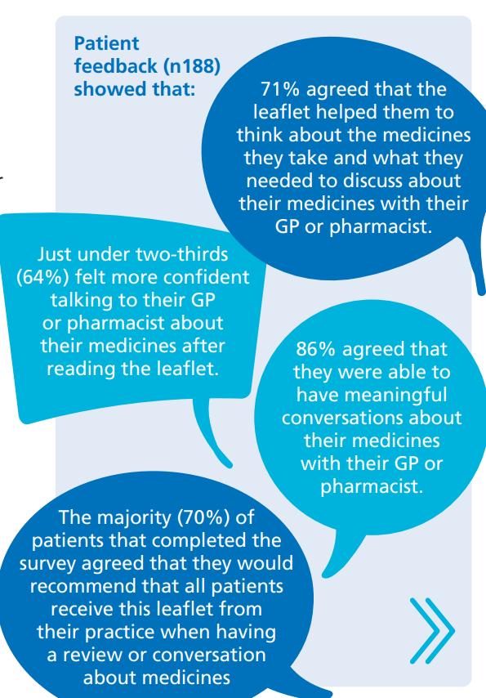

The materials are free to use and can be printed and used in paper format or shared electronically with patients via email, text or other electronic systems used within your workplace
An easy-read, audio version of the materials is available by scanning the QR code on each resource
The resources are available in the following languages:
• Arabic
• Bengali
• Gujarati
• Polish
• Panjabi Gurmukhi
• Punjabi Shahmukhi
• Urdu
• Romanian
• Somali

